Slide 1
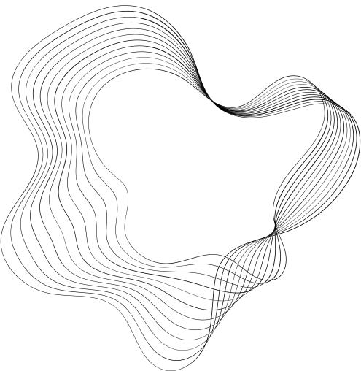

STOCK PRICE
PREDICTION USING
LSTM MODEL
GAURISHANKAR SWAIN

Slide 2
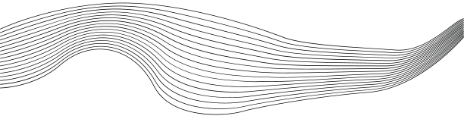
CONTENT
01
Project Overview
02
Deep Learning and LSTM
03
Data Preprocessing
04
LSTM Model and Evaluation
05
Price Predictions
06
Results and Conclusions

Slide 3



PROJECT OVERVIEW
We will be using historical stock price data to train our model, and making predictions for the next 30 days.
Our dataset contains the opening, closing, high, and low prices for the stock. We will be using closing price for this particular analysis.
In this project, we will develop a stock price prediction and forecasting model using LSTM neural networks in Python.

Slide 4

WHAT IS LSTM?
Long Short-Term Memory (LSTM) is a variant of RNN that is designed to address the problem of vanishing gradients. When training deep RNNs, the gradients can become very small and cause the network to stop learning. LSTMs solve this problem by introducing a "memory cell" that can selectively remember or forget information from previous time steps. The memory cell is controlled by "gates" that regulate the flow of information into and out of the cell. This allows the LSTM to learn long-term dependencies in sequential data, making it particularly effective for tasks such as speech recognition and machine translation.

Slide 5




DATA PREPROCESSING
Objective n° 1
Objective n° 2
Objective n° 3
We will preprocess our data by removing any missing or incomplete data, and selecting the Close column as the target variable for prediction.
We will then split the data into training and testing datasets using the train_test_split() function from sklearn.
The training and testing datasets will be normalized using MinMaxScaler from sklearn.

Slide 6


LSTM MODEL AND EVALUATION
Model
We will define and train an LSTM model using the training dataset. The LSTM model will have 3 layers and 50 neurons per layer
We will use the mean squared error (MSE) as the loss function, and the Adam optimizer to optimize the weights.
Evaluation
We will evaluate the performance of our model using the testing dataset.
We will calculate the root mean squared error (RMSE) to measure the difference between the predicted and actual closing prices.

Slide 7
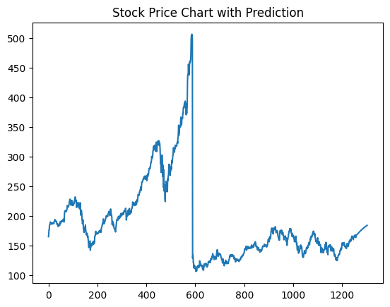

PRICE PREDICTION
We will use the trained LSTM model to make predictions for the next 45 days and data of the last 100 days would be used to make the prediction
We will normalize the data using the same MinMaxScaler that we used for training and testing our model.

Slide 8
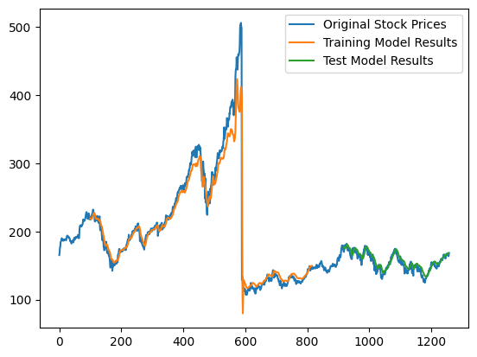
RESULTS
We will visualize the actual and predicted stock prices for the last 60 days, as well as the predicted prices for the next 30 days and use matplotlib to create a plot of the actual and predicted prices.

Slide 9



CONCLUSIONS
LSTM neural networks can be used to develop accurate stock price prediction and forecasting models.
By using historical stock price data, we can train our model to make predictions for the future.
Our LSTM model was able to accurately predict the closing prices of a particular stock.

Slide 10

THANKS FOR YOUR TIME.
INVEST WISELY

